Slide 1
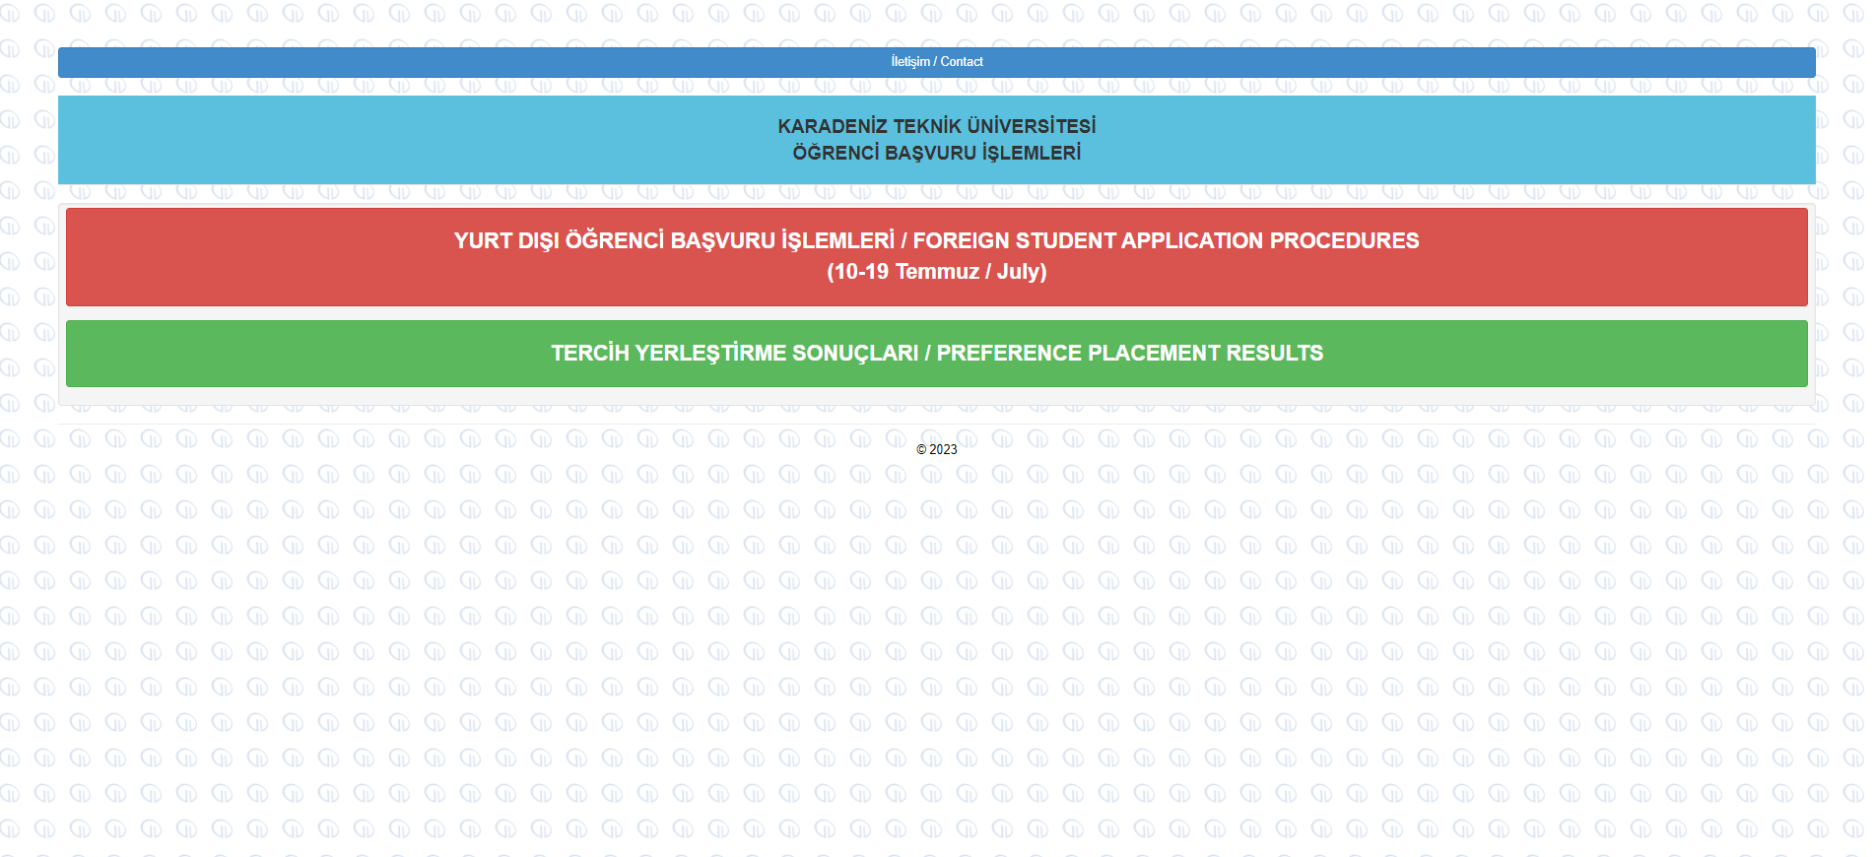
Applications will be taken online at http://www.ktu.edu.tr/oidb on 10-19 July.
Click on the red section to apply for preferences.
Click on the green section to check the placement results on 24th of July.

Slide 2
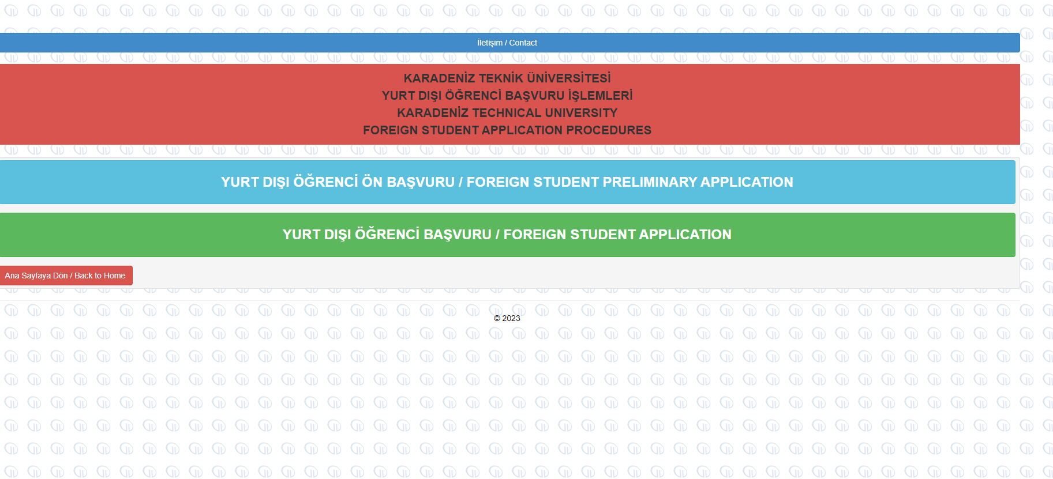
Click on the Foreign Student Preliminary Application to proceed.

Slide 3
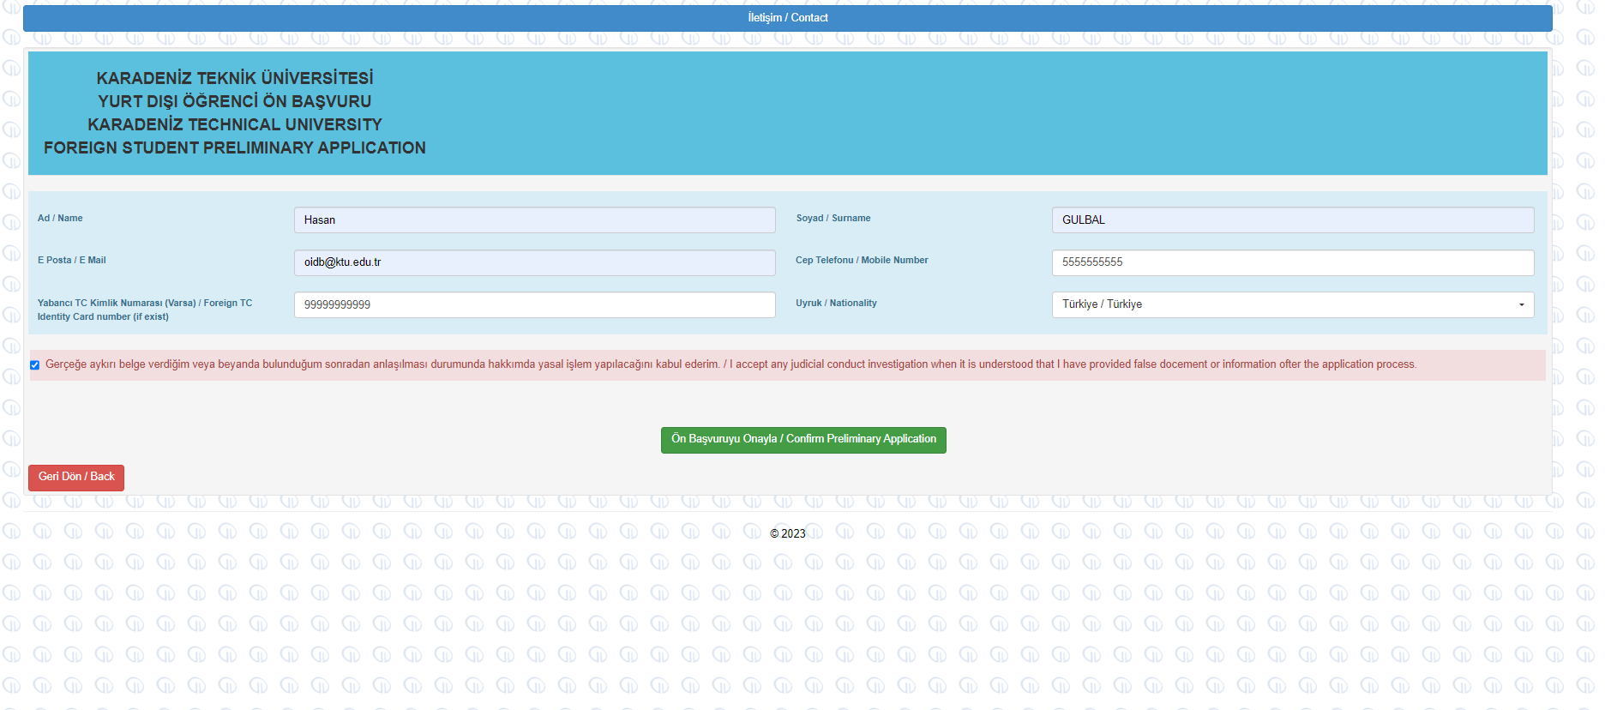
Fill in the required information in the preliminary application accurately.
Verification codes, notification e-mails, etc. will be sent to you via the e-mails registered in this section.

Slide 4
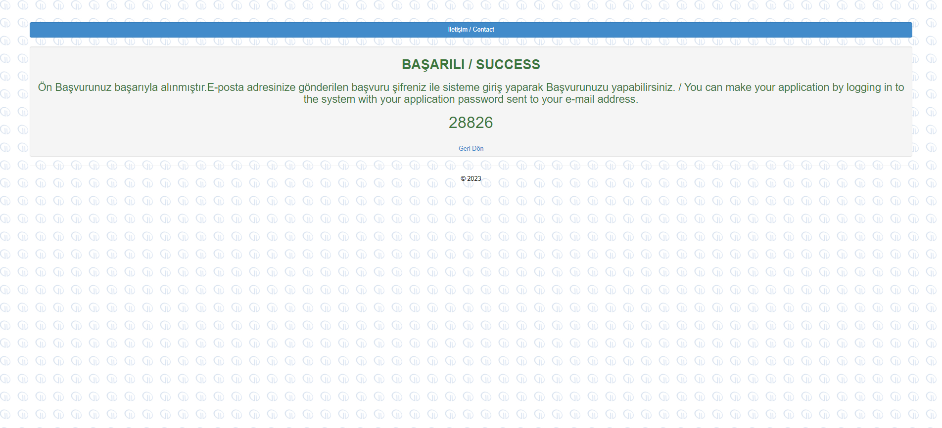
When the preliminary application is completed, you will get an application number and an e-mail with a password to log in to the application system.

Slide 5
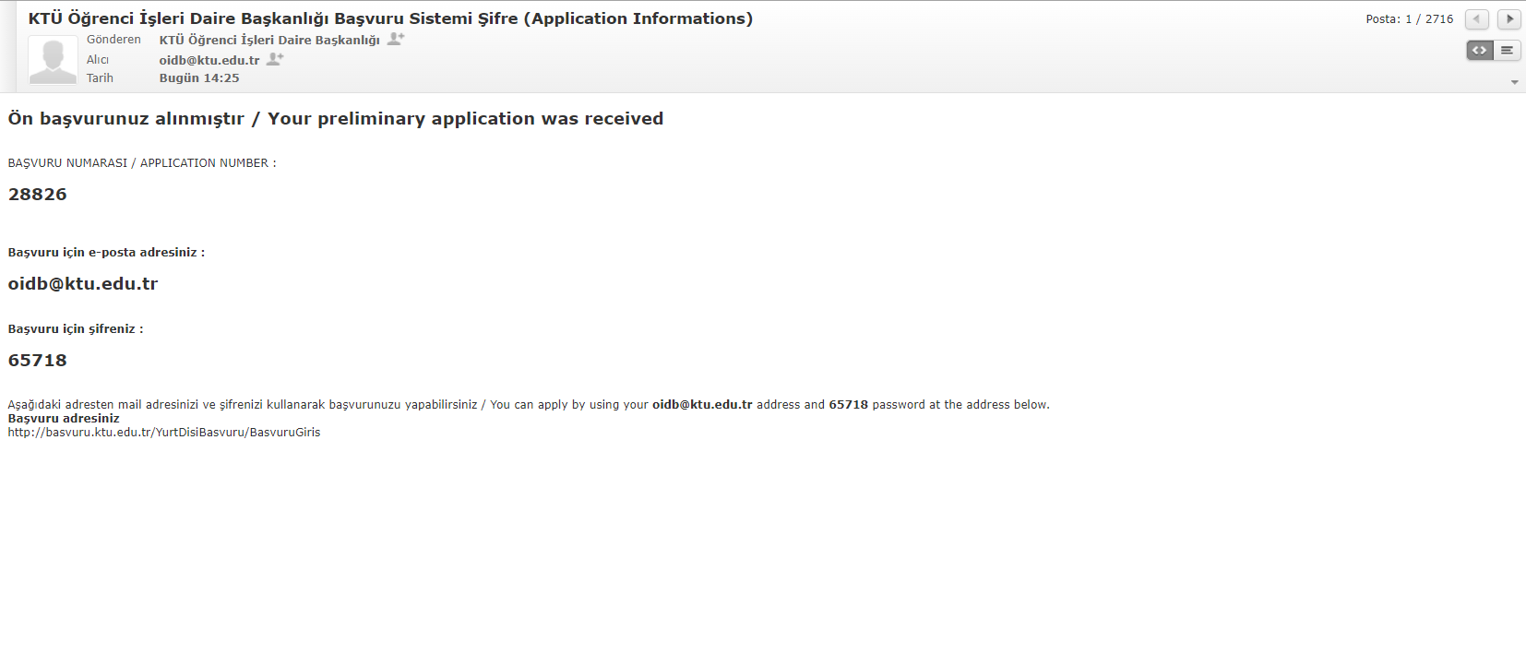
password
The application number and password are sent to the e-mail address you registered in the system.
With this password, you can log in to the application system.

Slide 6
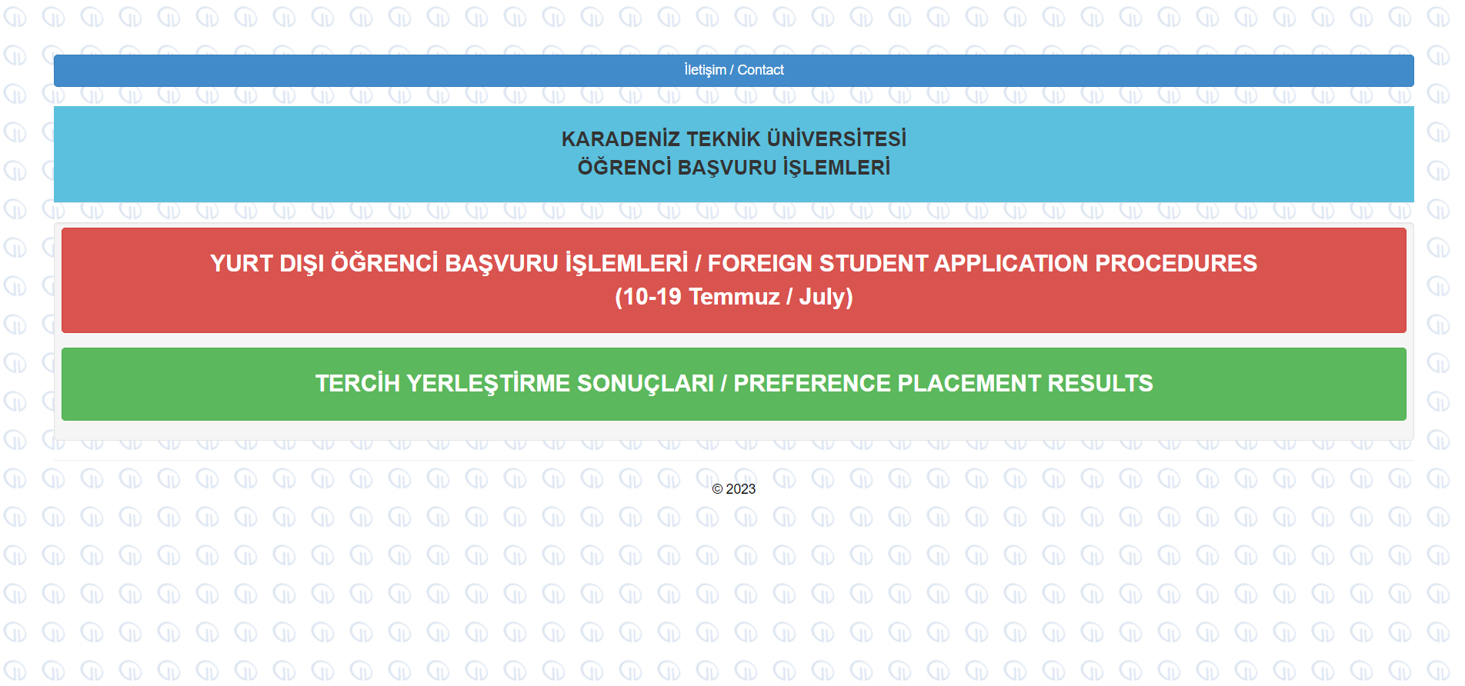
After the preliminary application, return to the main page to make preferences and upload the required documents.

Slide 7
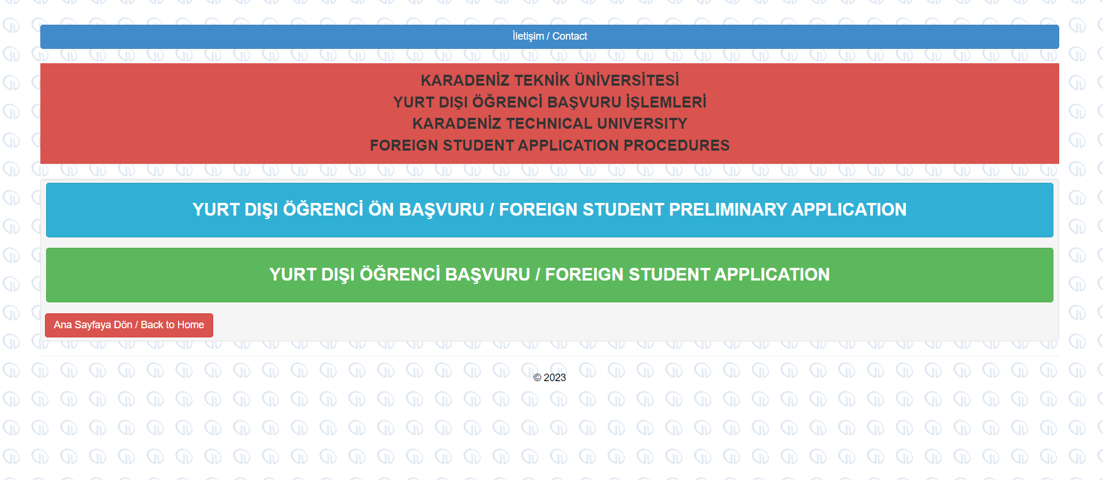
Click on the Foreign Student Application.

Slide 8
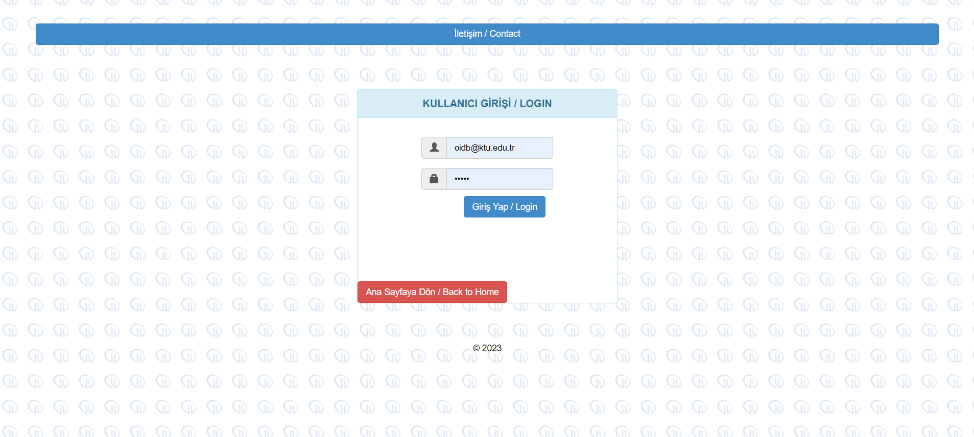
Use your registered e-mail and password to log into the system.

Slide 9
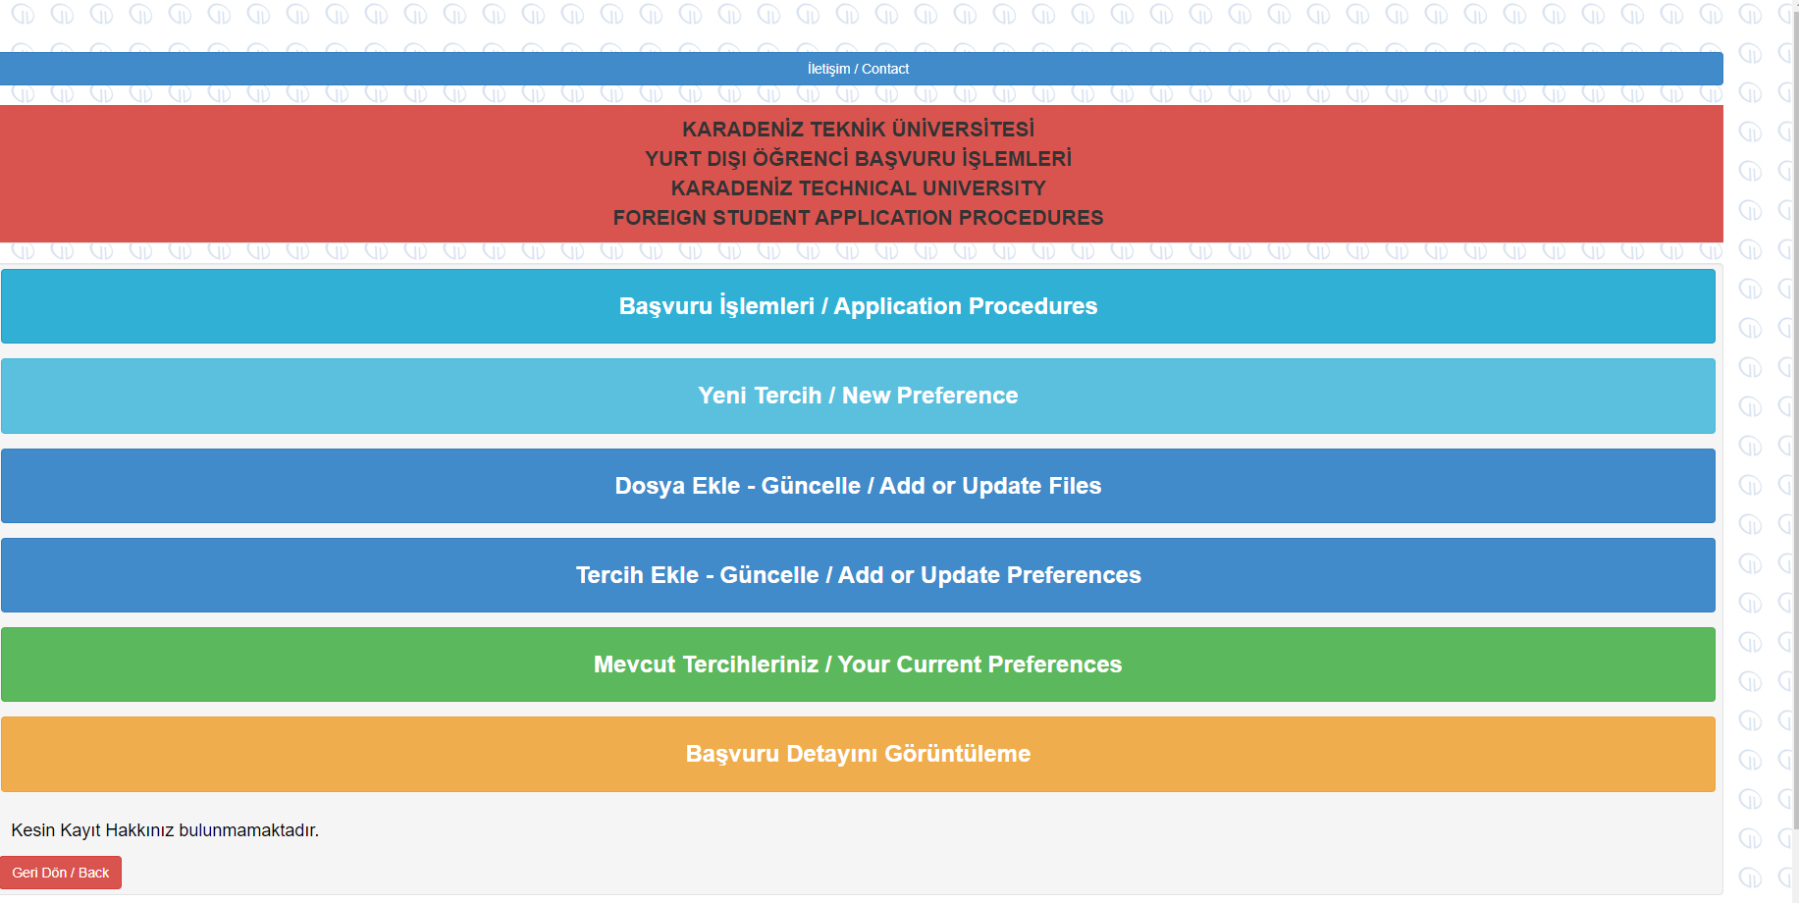
You can use these sections to apply, make preferences, upload the required documents and update your information on 10-19 July.

Slide 10
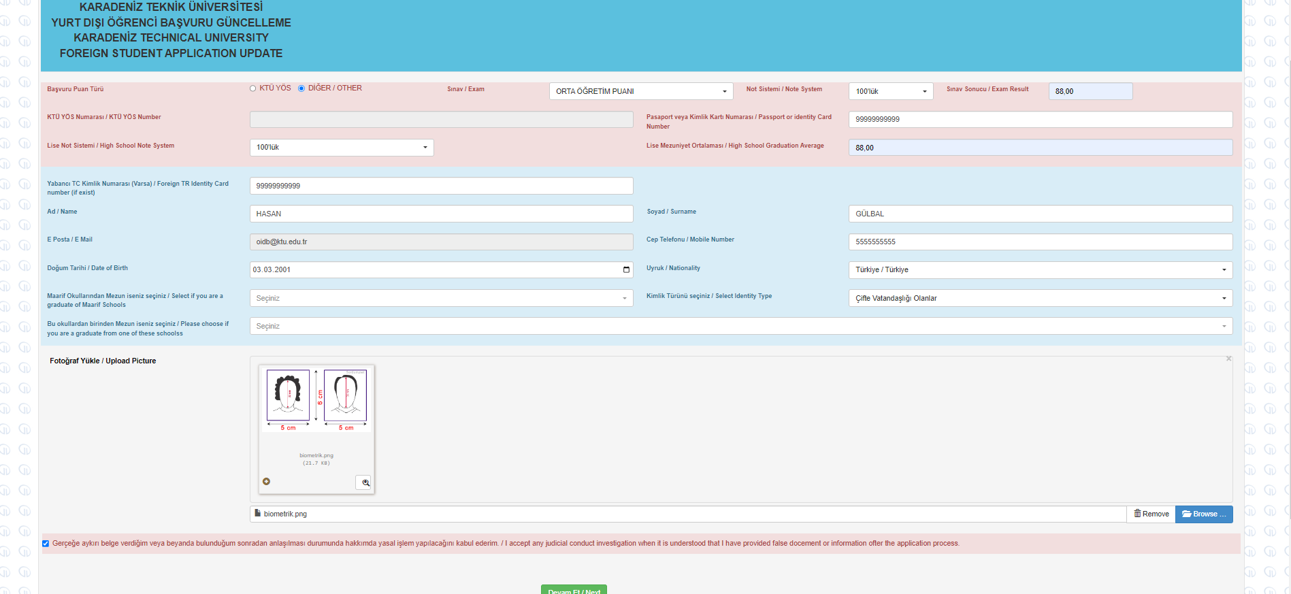
In this section, your KTÜYÖS and TRYÖS exam scores are automatically received.
For other exams/scores, please choose your score in the list and fill in the required information carefully.
Your photo should be taken 50 mm x 60 mm in size biometrically within the last six months.

Slide 11
Click here to prefer a maximum of five programs.

Slide 12
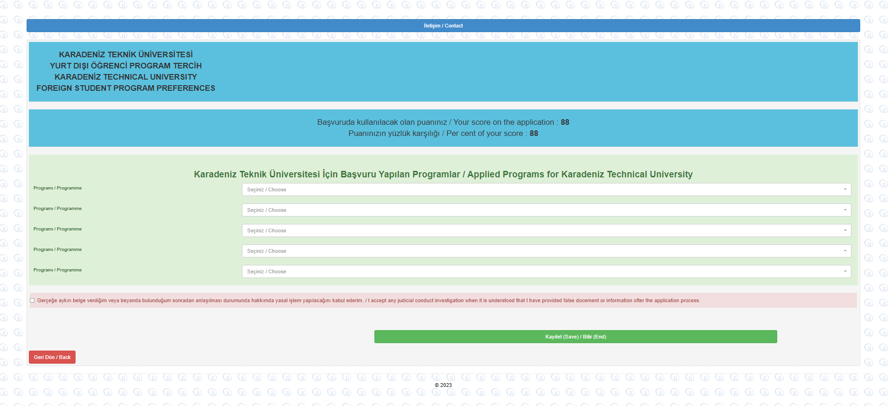
Prefer the departments that you want to be placed most at first.
In case of additional placement applications, students who are placed at a department in the first placement cannot apply for other placements. So, please do not prefer a department that you will not want to be registered.
After you submit your preferences, you can return to the main page.

Slide 13
Click here to upload the required documents.

Slide 14
You can update your preferences on 10-19 July.

Slide 15
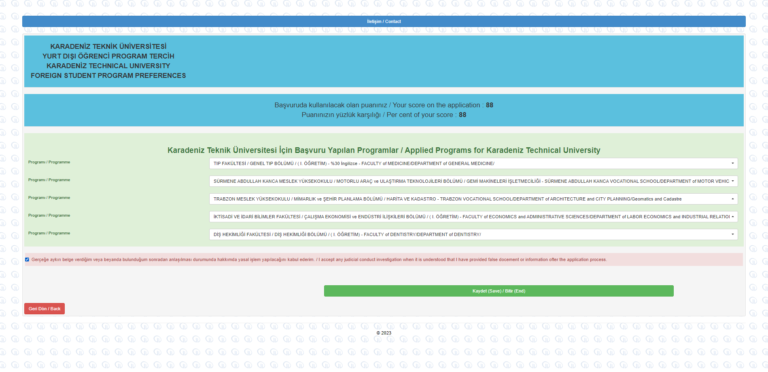
If you update your preferences on 10-19 July, please do not forget to save the page.

Slide 16
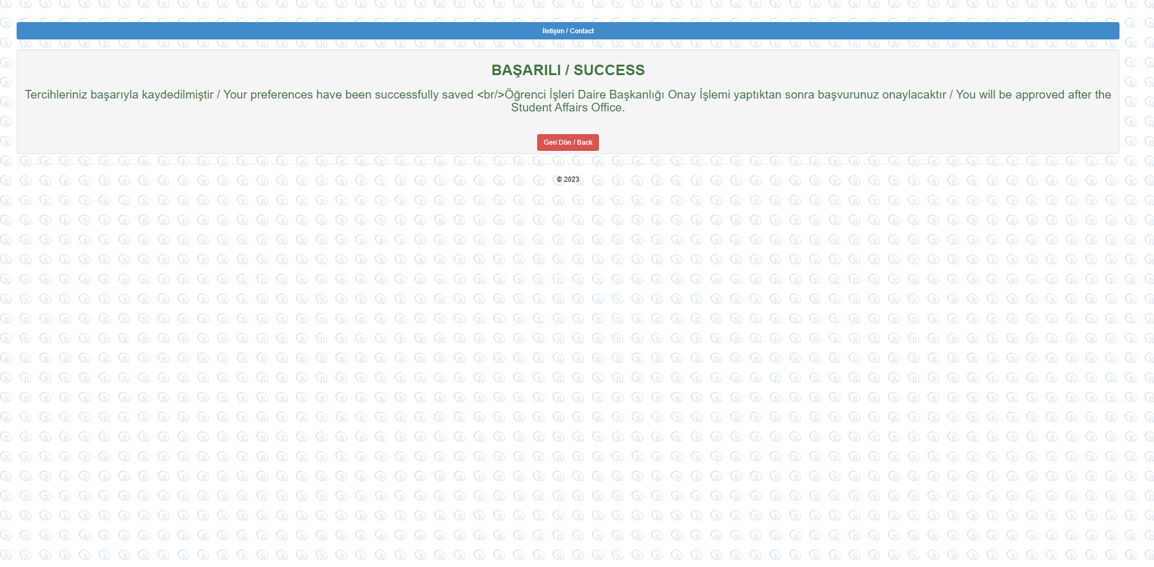
When you successfully update your preferences, you will receive an e-mail.

Slide 17
You can check your preferences in Your Current Preferences section.

Slide 18
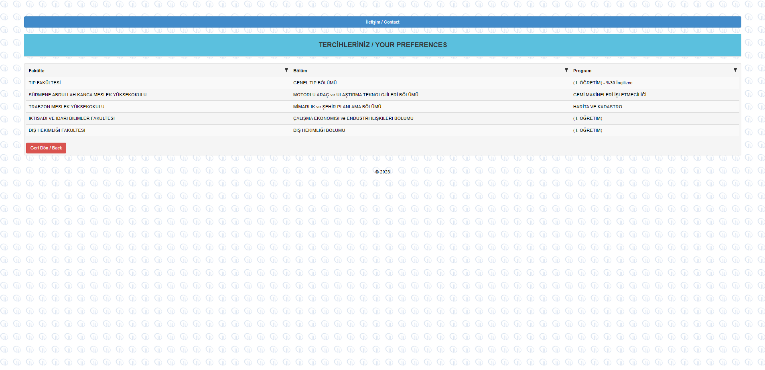
You can check the current status of your preferences to be evaluated here.

Slide 19
Click here to check your application

Slide 20
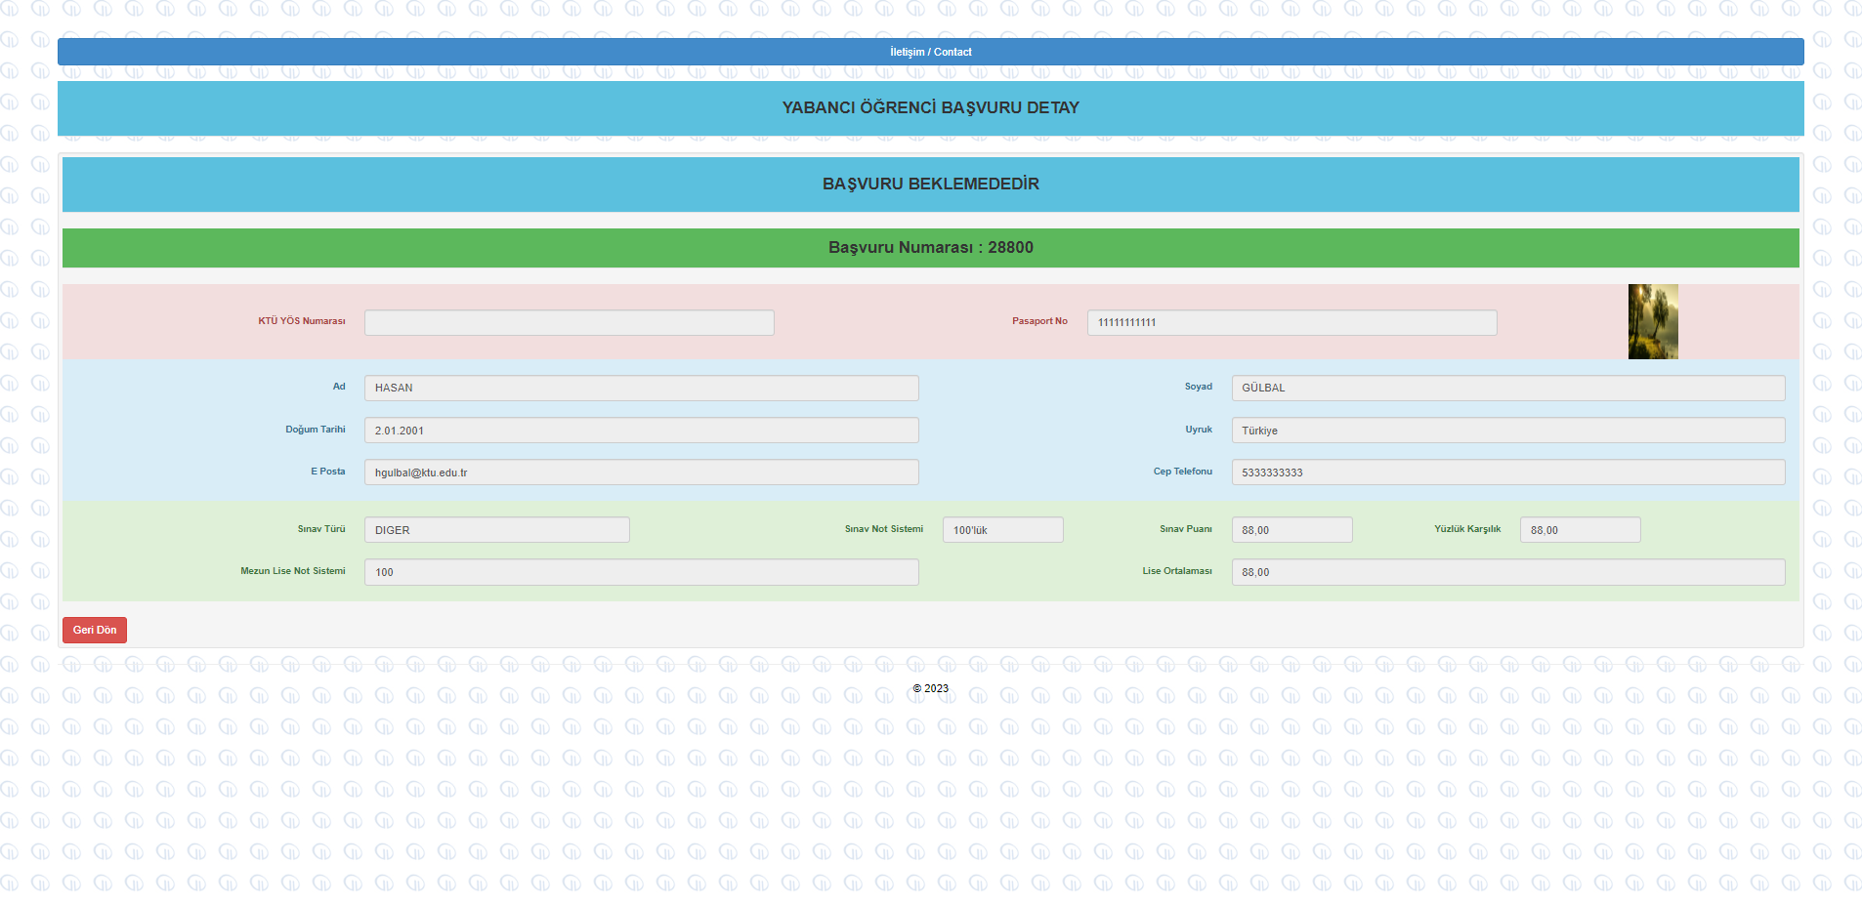
If you see any inaccurate/missing information, you can update your information in the previous sections on the main page.
In case of realizing any mistake during the evaluation process, your application will be rejected and you will be sent an e-mail explaining the problem to make you update your information.
So, please check your e-mail account frequently on 10-19 July.

